Slide 1


Brent Crude Oil-Price Prediction
Group - 4

Slide 2
OBJECTIVE
Crude oil is a vital natural resource with a complex global impact. This presentation delves into its composition, extraction methods, and global distribution of reserves. We'll examine the dynamic market forces influencing prices and demand while addressing the pressing environmental concerns surrounding its extraction and consumption. Additionally, we'll explore its profound economic significance across various industries and highlight recent technological advancements and regulatory frameworks shaping the industry. Insights into investment opportunities and considerations will be provided, alongside discussions on its social, geopolitical, and sustainability implications. Together, these factors paint a comprehensive picture of the multifaceted role crude oil plays in our world.
Crude oil is typically obtained through drilling, where it is usually found alongside other resources, such as natural gas (which is lighter, and therefore sits above the crude oil) and saline water (which is denser, and sinks below). It is then refined and processed into a variety of forms, such as gasoline, kerosene and asphalt, and sold to consumers. Although it is often called "black gold," crude oil has ranging viscosity and can vary in color from black and yellow depending on its hydrocarbon composition. Distillation, the process by which oil is heated and separated in different components, is the the first stage in refining.
Economically, crude oil holds significant sway across numerous industries, underpinned by technological advancements and regulatory frameworks that continually shape the industry's landscape. This intricate interplay between economic, environmental, and technological factors underscores the multifaceted role that crude oil plays in our interconnected world.
Strategies for managing risks associated with crude oil price fluctuations, such as hedging and diversification, need to be explored, along with corporate social responsibility initiatives and emerging technologies' potential impacts on efficiency and sustainability. Additionally, an exploration of crude oil's role in global trade and its broader economic ramifications, particularly for developing and emerging economies, would provide a comprehensive understanding of its multifaceted influence on the global stage.

Slide 3
EDA Exploratory Data Analysis (EDA) is an analysis approach that identifies general patterns in the data. These patterns include outliers and features of the data that might be unexpected. EDA is an important first step in any data analysis.

Slide 4
EDA - Insights Of Brent
The Brent Crude oil price, a benchmark for global oil trading, has experienced significant fluctuations since its inception. In the early 2000s, Brent Crude prices were relatively stable, hovering around $20-$30 per barrel due to steady global demand and production levels. However, the mid-2000s saw a sharp rise in prices, driven by geopolitical tensions, supply disruptions, and increased global demand, particularly from emerging economies like China and India. By mid-2008, Brent Crude prices peaked at around $140 per barrel, sparking concerns about energy security and inflationary pressures worldwide.
The subsequent years witnessed a dramatic reversal, as the global financial crisis led to a sharp decline in oil prices. By December 2008, Brent Crude had plummeted to below $40 per barrel as demand contracted amid economic slowdowns across major economies. However, prices gradually recovered as economic conditions improved and stimulus measures were implemented, reaching above $100 per barrel by early 2011.
The period from 2014 to 2016 marked another significant downturn for Brent Crude prices, largely attributed to a combination of factors including oversupply from the US shale boom, OPEC's decision to maintain production levels, and weakening global demand. Prices fell below $30 per barrel in early 2016, reaching their lowest levels in over a decade.
Since then, Brent Crude prices have exhibited volatility but have generally remained below pre-2014 levels, influenced by factors such as OPEC production agreements, geopolitical tensions, fluctuations in global demand, and more recently, the COVID-19 pandemic's impact on oil consumption. As of [current date], Brent Crude prices are [current price] per barrel, reflecting the ongoing uncertainties and complexities shaping the global oil market.

Slide 5
Visualization And Analyzed Data From The Historical Data Of Brent

Slide 6
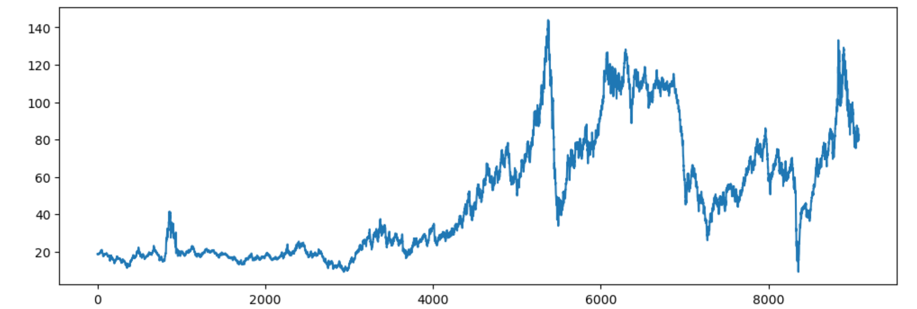
Date v/s Price Plot

Slide 7
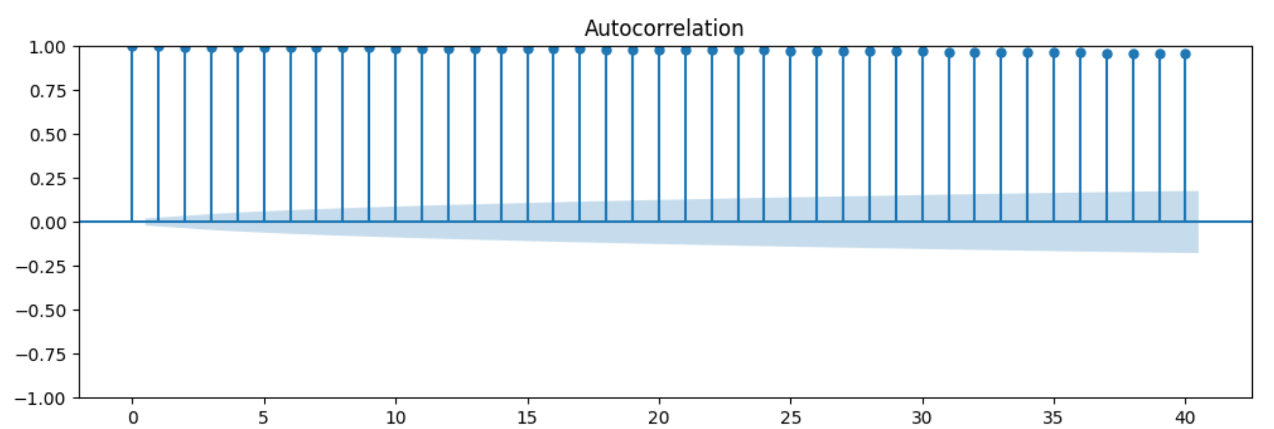
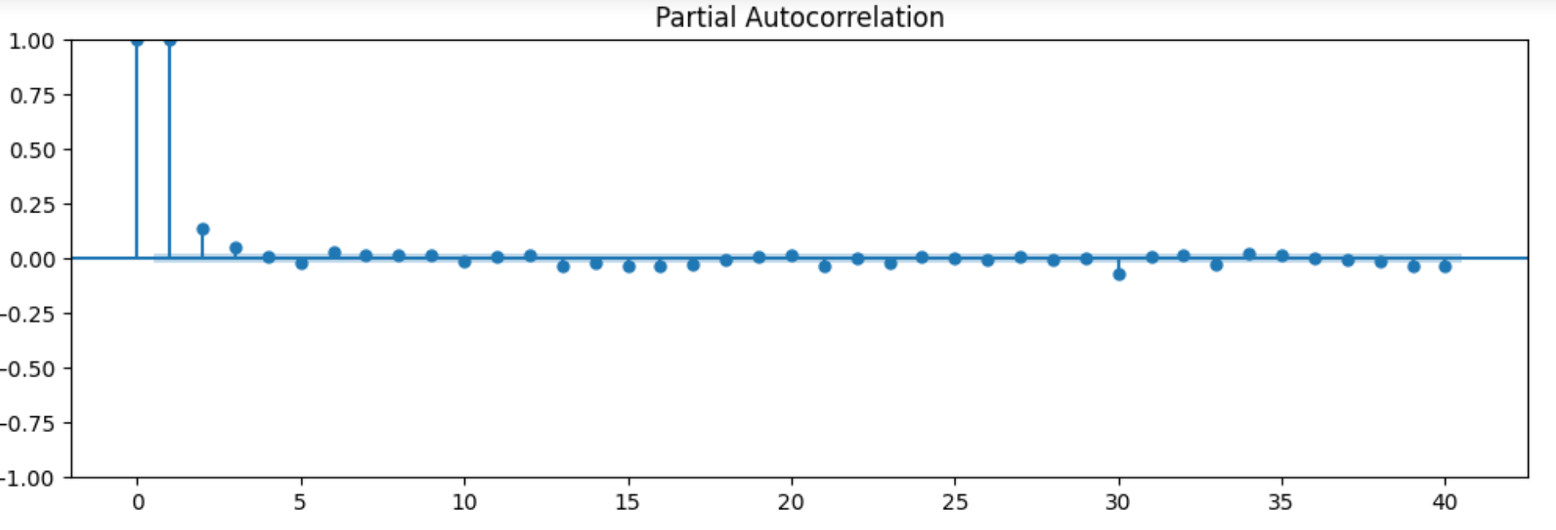
Autocorrelation And Partial Autocorrelation

Slide 8
The Autocorrelation Function (ACF) graph is a powerful tool for understanding the patterns and relationships within a time series dataset. It illustrates how current values correlate with past values at various time lags. The y-axis of the graph represents the correlation coefficient, which ranges from -1 to 1. A positive correlation indicates that data values tend to move in the same direction over time, while a negative correlation suggests they move in opposite directions.
A correlation close to zero signifies no linear relationship between current and past values. Meanwhile, the x-axis denotes the time lag, or the number of time units between current and past observations.
On the other hand, the Partial Autocorrelation Function (PACF) graph delves deeper into the relationships within the same time series data by accounting for intermediate lags. It helps identify the appropriate order of autoregressive (AR) models for forecasting. Similar to the ACF graph, the y-axis of the PACF graph represents the partial correlation coefficient, ranging from -1 to 1. This coefficient indicates the strength and direction of the relationship between current and past values, after removing the effects of other lags.
The x-axis still represents the time lag, maintaining consistency with the ACF graph. By analyzing both the ACF and PACF graphs, analysts can gain valuable insights into the temporal dynamics of the dataset, including identifying potential seasonality, cyclicality, and determining the optimal parameters for forecasting models.

Slide 9
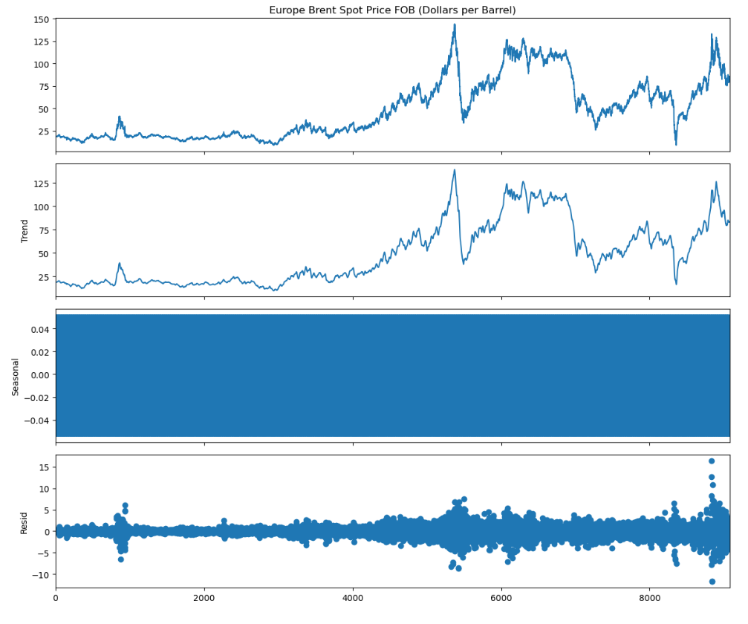
Nature of Brent Crude Oil Over The Time

Slide 10
Deployment Model

Slide 11
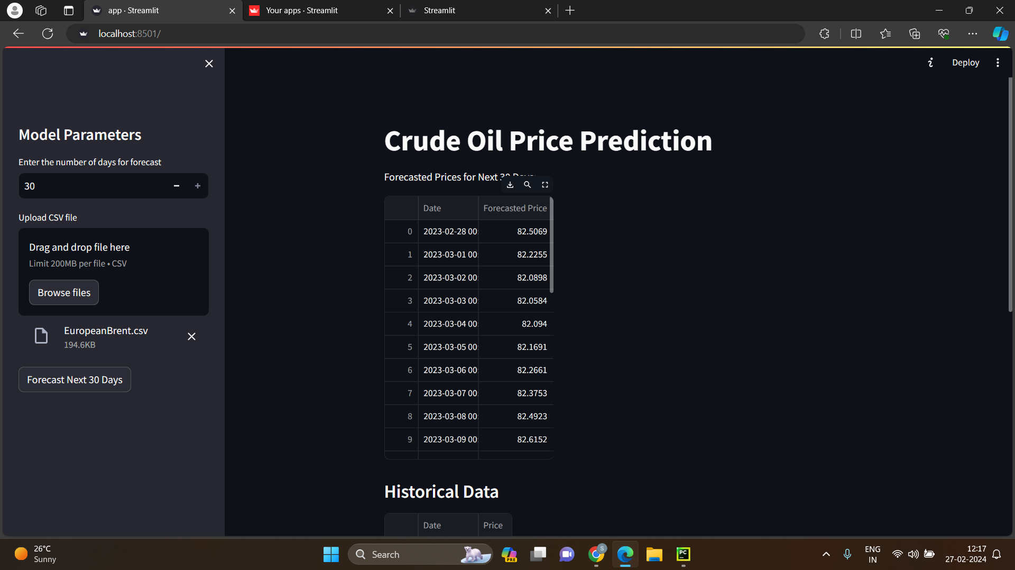

Slide 12
Streamlit With LSTM Model
Streamlit is a powerful Python library used for building interactive web applications. When combined with an LSTM (Long Short-Term Memory) model, it enables the creation of user-friendly interfaces for predicting sequential data. In a presentation, Streamlit's integration with LSTM models can be highlighted as a means to deploy and showcase predictive models to a broader audience.
The presentation would explain the process step-by-step: installing Streamlit and required libraries, developing an LSTM model using TensorFlow or PyTorch, creating the Streamlit web application, running the application, and interacting with it to make predictions. Key features of the Streamlit app, such as user input fields and prediction display, would be demonstrated. Benefits of using Streamlit with LSTM models include its simplicity for creating interactive interfaces without requiring extensive web development knowledge, thus democratizing access to complex predictive models. This integration facilitates seamless communication of model insights and predictions to stakeholders, enhancing decision-making processes.
Additionally, the ability to visualize and interact with LSTM model predictions in real-time through a web browser enhances user engagement and understanding. Overall, Streamlit's compatibility with LSTM models offers a user-friendly platform for deploying, exploring, and utilizing predictive capabilities in various domains.

Slide 13
Challenges Faced With Other Models
1. Assumption Violation: SARIMA and ARIMA models rely on specific data structure assumptions, and deviations from these assumptions can lead to poor model performance.
2. Limited Capacity: Traditional models like LR, RF, and KNN may struggle to capture the nonlinear and complex relationships present in crude oil price data, resulting in suboptimal predictions.
3. Hyperparameter Sensitivity: Models such as RF and KNN require careful tuning of hyperparameters, and failure to find optimal values can significantly impact predictive performance.
4. Data Stationarity: SARIMA and ARIMA models assume stationarity in time series data, and failure to achieve or maintain this can affect model accuracy.
5. Seasonality and Trends: Traditional models may have difficulty capturing seasonal patterns, trends, and long-term dependencies inherent in crude oil price data, leading to inaccurate predictions.
6. Complexity-Interpretability Trade-off: Models like RF and KNN may offer higher accuracy but lower interpretability compared to simpler models like LR, making it challenging to explain predictions to stakeholders.
7. Integration with External Factors: Traditional models may face challenges in incorporating external factors such as geopolitical events and economic indicators into the prediction process, despite their significant influence on crude oil prices.

Slide 14
Challenges Faced With LSTM
1. Data Quality and Availability: Obtaining accurate historical crude oil price data poses challenges due to data gaps, inconsistencies, and limited availability.
2. Feature Selection: Identifying relevant predictors influencing crude oil prices is difficult due to the multifactorial nature of price fluctuations.
3. Model Complexity: LSTM models require intricate hyperparameter tuning, including layers, units, and sequence lengths, especially daunting for large datasets.
4. Overfitting: LSTM models are prone to overfitting, particularly with limited data or excessive complexity, resulting in poor generalization on unseen data.
5. Data Preprocessing: Raw data preprocessing for LSTM models, such as handling missing values and feature transformation, can be complex and affect model performance.
6. Training Time: LSTM models typically demand longer training times compared to traditional models like RF, KNN, and LR, posing challenges for large datasets or time-sensitive predictions.
7. Interpretability: LSTM models are often considered black-box, complicating the interpretation of feature influences crucial for decision-making in the crude oil market.
8. Generalization and Robustness: Ensuring LSTM models generalize across various time periods, market conditions, and geographic regions is challenging due to the inherent volatility and uncertainty in the crude oil market.

Slide 15
METHODOLOGY
Data Collection: Gather historical data on oil prices. This data typically includes the date and the price of oil at various time intervals (e.g., daily, weekly, monthly). You can obtain this data from financial websites, government agencies, or commercial data providers.
Data Preprocessing: Prepare the data for training the LSTM model. This involves steps such as : Cleaning the data: Handling missing values, outliers, or any inconsistencies in the data. Normalization: Scaling the data to a small range, typically between 0 and 1, to improve the training process and convergence of the model.
Feature selection: Choosing relevant features that can help the model learn patterns in the data. In this case, the historical oil prices would be the primary feature Sequence Generation: Convert the time series data into sequences that the LSTM model can process. Each sequence consists of a fixed number of historical prices (e.g., the prices of the past 30 days).
This step helps the model learn temporal patterns in the data. Model Building: Build the LSTM model using a deep learning framework like Tensor Flow. Model Training: Train the LSTM model using the prepared data. During training, the model learns to predict future oil prices based on the historical price sequences.
The training process involves minimizing a loss function (e.g., Mean Squared Error) using optimization techniques like stochastic gradient descent Model Evaluation: Evaluate the trained model's performance using validation data that the model hasn't seen during training. Common evaluation metrics for regression tasks include Mean Absolute Error (MAE), Mean Squared Error (MSE), and Root Mean Squared Error (RMSE).Prediction: Once the model is trained and evaluated, use it to make predictions on unseen data, i.e., future oil prices. Input sequences of historical prices into the trained model to generate predictions for the next time step(s)

Slide 16
RESULTS
STM models can capture complex temporal patterns in time series data, making them suitable for modeling the dynamics of oil prices. The choice of features plays a crucial role in the performance of LSTM models for oil price prediction. In addition to historical oil prices, other relevant features may include economic indicators , geopolitical events. The accuracy depends on various factors such as the quality and quantity of data, the choice of features, the model architecture, and the training process. In some cases, LSTM models have demonstrated relatively high accuracy in predicting oil prices over short-term horizons, while their performance over longer-term horizons may be less reliable due to the inherent volatility and complexity of oil markets. . Despite their ability to capture complex temporal patterns, LSTM models are often perceived as "black-box" models, necessitating efforts to enhance model interpretability for better understanding and trust in the results obtained. Additionally, incorporating uncertainty and risk analysis techniques, along with validation and sensitivity analysis, further enriches the evaluation process, offering insights into the model's robustness and potential limitations. Overall, considering these factors holistically contributes to a comprehensive assessment of the results obtained from LSTM models for oil price prediction.

Slide 17
ADVANTAGES
Accurate oil price predictions offer numerous advantages across various sectors and stakeholders. Beyond the obvious benefits of cost reduction and market analysis for businesses, these forecasts play a crucial role in risk management, strategic planning, and regulatory compliance. By leveraging oil price predictions, businesses can hedge against risks associated with volatile oil prices, ensuring stability in operational costs and financial resilience. Moreover, energy-intensive industries can utilize these forecasts for long-term strategic planning, guiding investment decisions and resource allocation strategies. Regulatory compliance is also facilitated, as companies can align their operations with government regulations related to energy usage and emissions standards. Additionally, accurate oil price predictions enable supply chain optimization, leading to improved efficiency and cost savings throughout the supply chain. Beyond the business realm, investors can make informed investment decisions, policymakers can formulate effective energy policies, and consumers can adjust their behavior towards more sustainable alternatives, reducing environmental impact. Furthermore, these predictions have implications for global geopolitics and international relations, influencing diplomatic strategies and trade agreements among oil-producing and consuming nations. In essence, accurate oil price predictions provide a foundation for informed decision-making, risk management, and strategic planning across industries, stakeholders, and global economies, contributing to economic stability and sustainability in a dynamic and interconnected world.

Slide 18
APPLICATIONS
Consumer Welfare: Anticipating changes in oil prices allows consumers to adjust their spending patterns and make informed choices regarding transportation, energy consumption, and household budgets. Financial Markets: Oil price predictions are vital for investors, traders, and financial institutions operating in commodity markets. Transportation Industry: The transportation sector relies heavily on oil-based fuels such as gasoline and diesel. Renewable Energy Sector: The renewable energy sector considers oil price predictions when evaluating the economic viability of renewable energy projects compared to conventional fossil fuels. Additionally, the renewable energy sector, which increasingly competes with conventional fossil fuels, considers oil sources, ultimately shaping the future trajectory of the global energy landscape. Thus, accurate oil price predictions when evaluating the economic viability of renewable energy projects. Precise forecasts guide investment decisions, technological innovations, and policy formulations aimed at promoting the transition towards sustainable energy predictions play a multifaceted role in shaping decision-making processes, optimizing resource allocation, and fostering resilience across diverse sectors and industries, ultimately contributing to economic stability and sustainability on a global scale.

Slide 19
Conclusion
Oil prices are influenced by a wide range of factors including geopolitical events, supply and demand dynamics, economic indicators, technological advancements, weather patterns, and regulatory changes. Different modeling approaches, such as time series analysis, econometric models, machine learning algorithms, and hybrid models, offer unique advantages and trade-offs. The choice of model depends on factors such as the nature of the data, prediction horizon, interpretability requirements, and computational resources available. Evaluating the performance of prediction models requires robust metrics that capture accuracy, reliability, and risk-adjusted returns. Common metrics include Mean Absolute Error (MAE), Mean Squared Error (MSE), Root Mean Squared Error (RMSE), directional accuracy, and financial performance measures. By leveraging these diverse modeling approaches and evaluation metrics, stakeholders can navigate the intricacies of oil price forecasting more effectively, enabling informed decision-making and risk management strategies in the dynamic oil market landscape.

Slide 20
THANK YOU

